Slide 1

Mental health in tech
Predicting whether employee need treatment or not…
Mental Health in Tech
-By Skillenza

Slide 2

Self-Intro
Hello, I'm Sivabalan, Computer Science and Engineering student. I'm passionate about technology and love controlling with data.
My goal is to contribute to the field of data science by leveraging my analytical skills and creativity to extract meaningful insights. In order to solidify my aspiration to become a Data Scientist, I have completed a 2-month internship as a Data Analyst at Dunzo Digital Pvt. Ltd., and also 1 week as IBM data Analyst. I have won InstaMinds-2022 and Participated in SIH Grand Finale-2022.
I enjoy staying updated on the latest trends and technologies. I Always Excited to connect with like-minded individuals who share my passion for data-driven solutions.

Slide 3
Problem Statement
We are given two datasets- employee_train.csv for train and employee_test.csv for predicting
The given Data set has Employee’s data working in Tech company and has some details about the mental pressure, stress level, working hours, etc.,
The problem stated was, as a data analyst we do need to analyze the data given and find whether a particular employee need mental treatment?
Using Machine Learning models is the main objective

Slide 4
Exploratory Data Analysis
Exploratory Data Analysis (EDA) is an essential process in data analysis that involves examining and summarizing data to gain insights, identify patterns, and understand the underlying structure.
EDA helps to uncover hidden patterns, relationships, and anomalies in the data, which can then guide further analysis and decision-making.
In EDA we go through the processes like Data Summarization, Data Visualization, Data -Cleaning and Preprocessing, Outlier Detection, etc.,

Slide 5
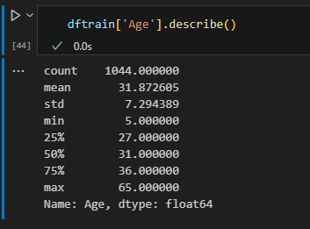
Summarization
Age is the only column with numeric data type
Using describe function I have got the mean, median mode, etc.,
From this summarization we can see that some outliers are there but we will deal it at last

Slide 6

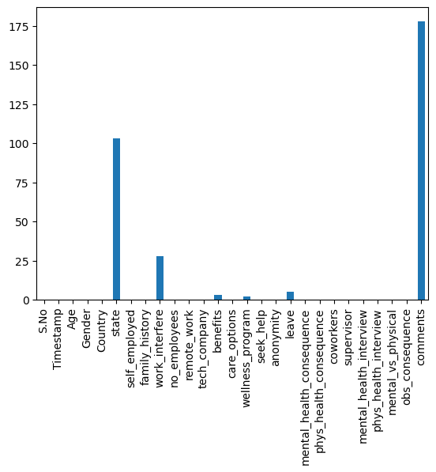

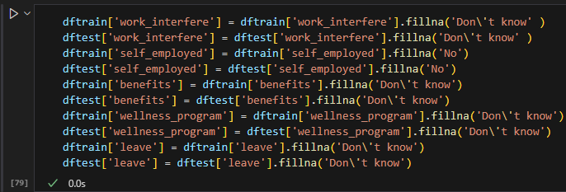
Missing values
Visualization of frequency of missing values in each columns
As State and comments columns are not important we are dropping them and handling the missing values for remaining.
And also dropping Timestamp and country as well

Slide 7
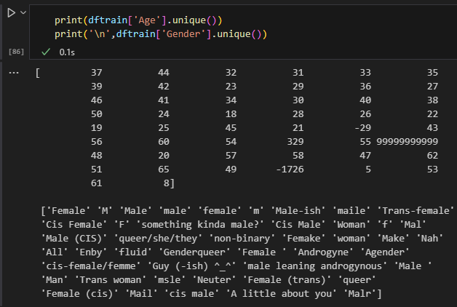

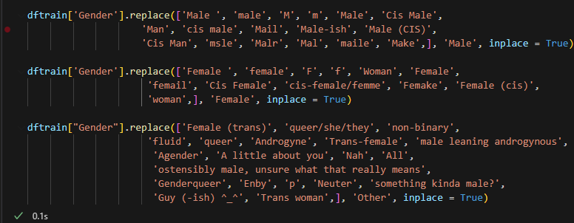
For age column we are dropping the rows for which the values are more than 100 and less than 0 as the count of them is low.
For Gender we are mapping male kind of values into male and similarly for female too and for undefinable values we are mapping it to others
Inconsistent Values
We can see that there are inconsistent data with age column and Gender.
In Gender field we can see that the male and female are denoted by different texts

Slide 8
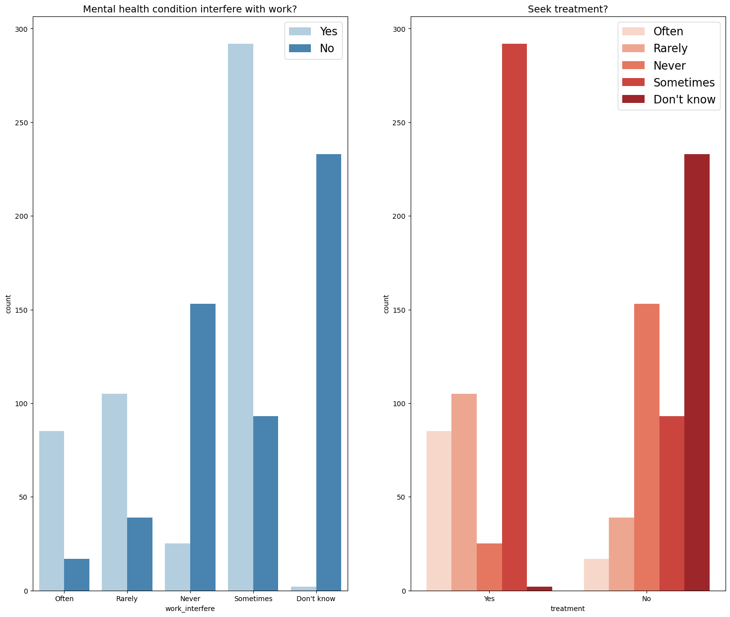
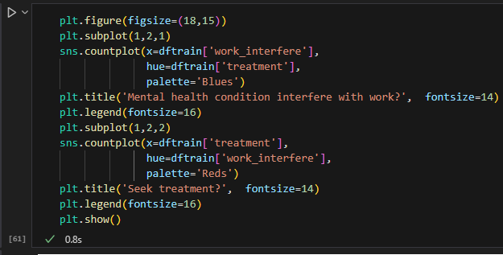
Visualization
work_interfere and treatment are strongly correlated.
People who seek treatment tend to be more influenced by mental health conditions at work

Slide 9
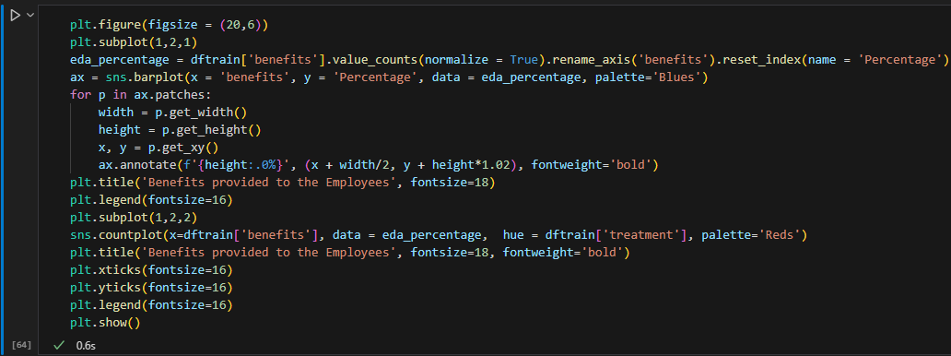
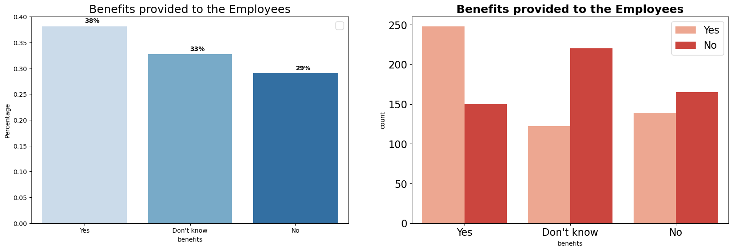

Slide 10


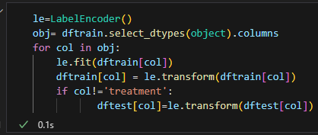
Outliers
We can see that the Age column having a skewness of 0.88 which implies that the outliers are at positive side
For handling Outliers I have used LOG Transformation over age column
Encoding
As mostly all the variables in the data are of the data type object we need to encode them as the machine cannot understand it.
I have used the Label encoder as the categories are less in number.

Slide 11

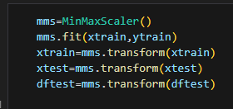
Splitting Data
First Splitting the data into independent and target features
For training and testing phase I have divided the data set into two
80% for train and 20% for test
Scaling
For standardizing the data I have used the MinMax Scaler which is available in Jupyter by default
It replaces all values between 0 to 1

Slide 12
Models built
As this is the Classification problem I have used the following models:
Logistic Regression
Decision Tree Classifier
Random Forest Classifier
AdaBoost Classifier
Gradient Boost Classifier
Support Vector Classifier
Gaussian Naïve Bayes

Slide 13
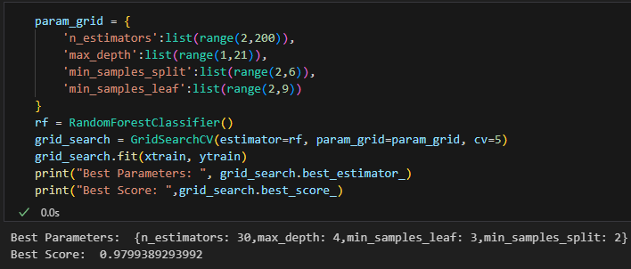
Evaluating and Tuning
For tuning the model for better performance I have used GridSearchCV

Slide 14
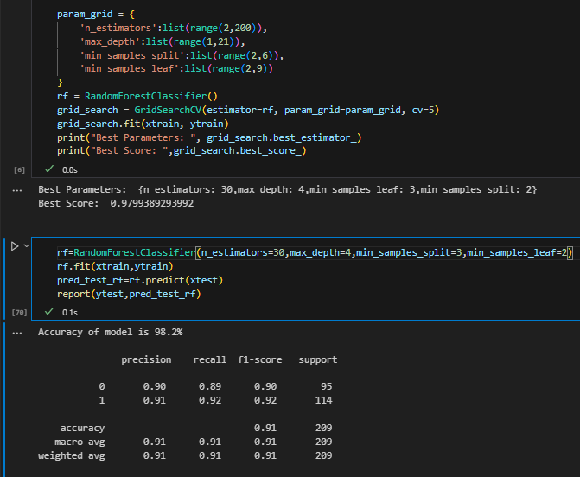
Best models:
Aiming for Low bias and Low Variance amongst all models built, I have chosen two models
Which is known as bias variance trade-off.
Random Forest Classifier
Random forest classifier gives me 97.9% for train and 98.2% for test.

Slide 15
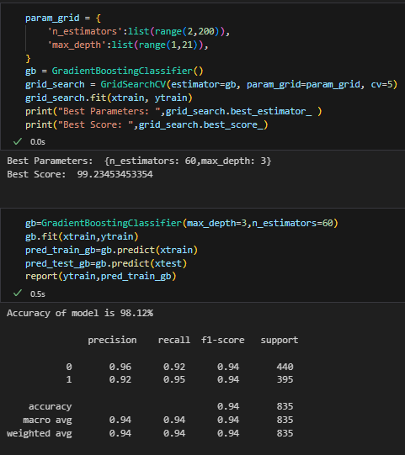
Gradient Boosting Classifier
GbBoost gives me 99.23% for train and 98.12 for test data
The f1-score are also sounds good
Conclusion:
Amongst two best models GbBoost fits well with the data
It gives the highest accuracy.

Slide 16


